Slide 1


Bridging the gap between NLP and PROLEG
Internship Research Summary Talk
H30.7.27 – H30.10.9
Supervisor: Prof. Ken Satoh
María Navas-Loro
Ontology Engineering Group
Universidad Politécnica de Madrid, Spain
mnavas@fi.upm.es
@mnavas314
18/10/2018
ETSII-UPM

Slide 2

Outline
Outline
Introduction
A bit of context
PROLEG
Frames
Challenges
ContractFrames
Other info
Conclusions

Slide 3

A bit of context
Introduction

Slide 4




Current situation
Legal cases
Knowledge
Laws

Slide 5


Ideal situation
Legal cases
Knowledge
Laws

Slide 6


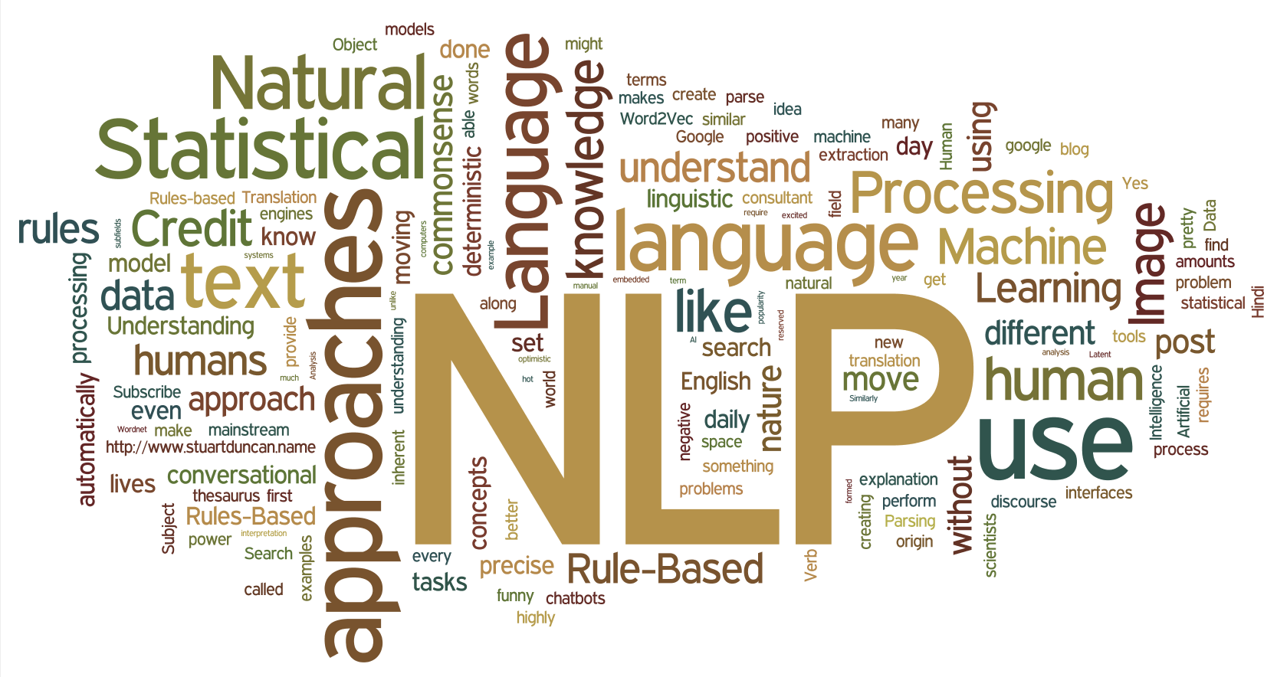


The Problem
PROLEG
Japanese Law
Natural Language Processing
Reasoning

Slide 7
PROLEG
Introduction

Slide 8
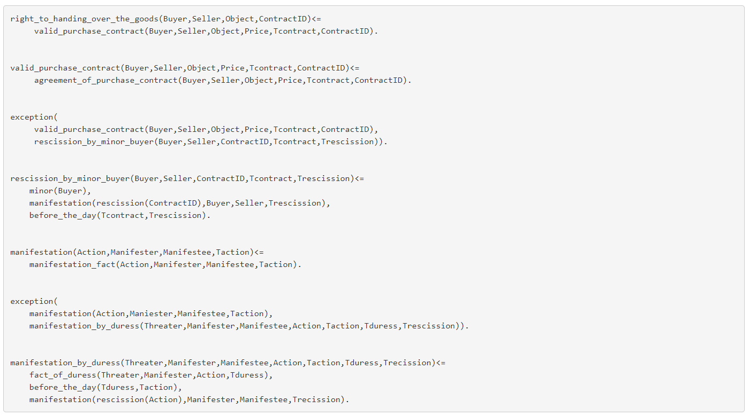
Example PROLEG knowledge base

Slide 9
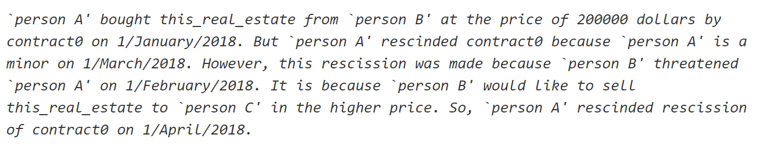
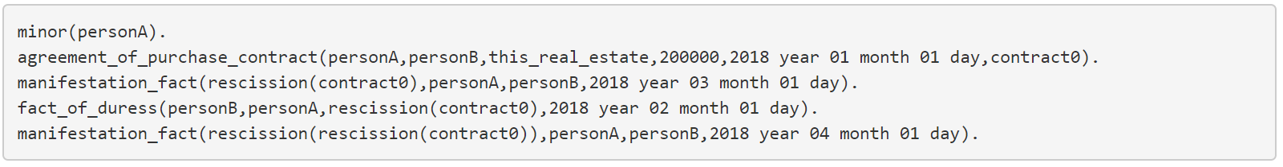
Example input
Facts in the text:
The purchase is uttered via a contract.
A rescission is claimed, adducing the fact that one of the parts was a minor.
A fact of duress (threatening) on one of the parts is issued. The cause of the ending of the contract is expressed in the following sentence.
The former rescission is rescinded, what makes the contract valid again.

Slide 10
If we have all the components…
Fact base
(case)
Knowledge base
(Law)

Slide 11
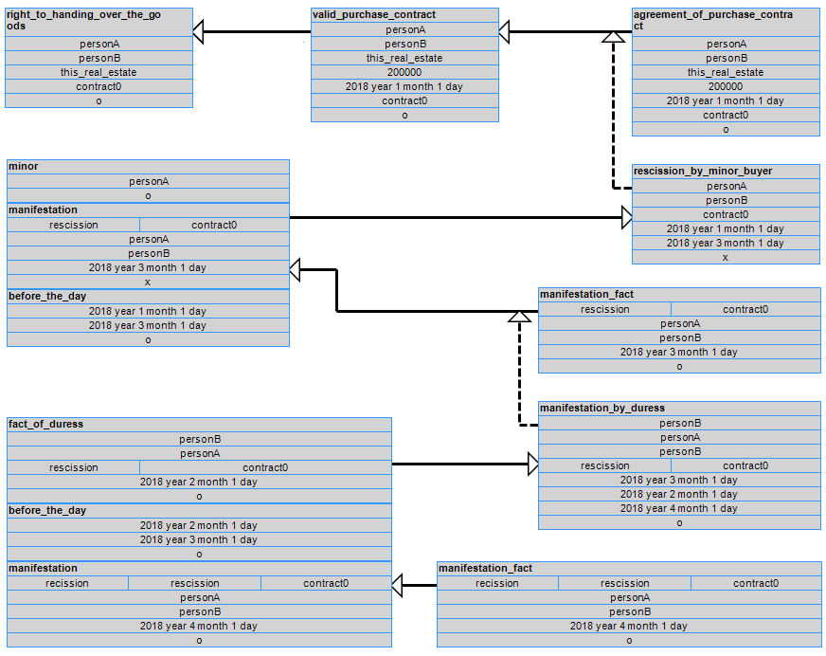
PROLEG reasoning process

Slide 12

FRAMES
Relevant events

Slide 13
The Problem
PROLEG
Japanese Law
REPRESENTATION
Natural Language Processing
Reasoning

Slide 14
Modelization of the events
We use frames:
A frame is “a data-structure for representing a stereotyped situation” (Minsky, 1975)
We will build frames for representing the different events that can affect to the status of a contract:
Establishment
Rescission
Duress
Then we will populate these frames.
Represent them in a standard way.
Output them as PROLEG facts.

Slide 15
Our Frames

Slide 16
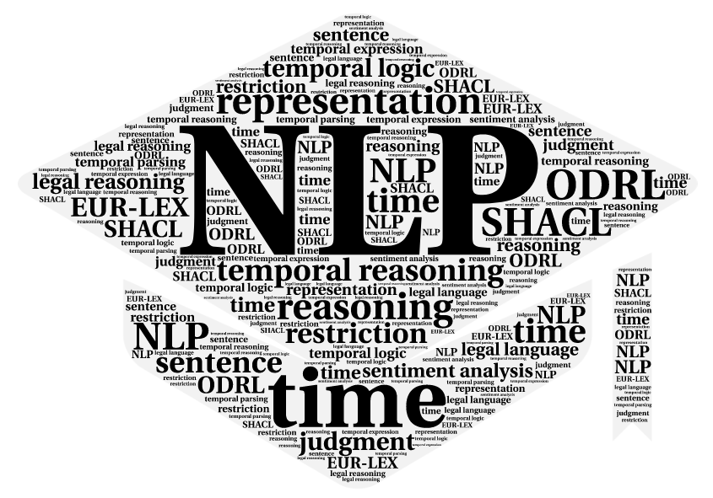
Challenges
Main obstacles

Slide 17
Challenges
Style and complexity:
“A sells a house to B.” → A tagged as a determiner
Relevance: Possibilities, intentions, negations…
“A would like to sell it to C for a higher price.”
Coreferences:
“A rescinded a contract. This rescission was later cancelled.”
Nesting and matching:
Derive information from one clause to another.
“A rescinded the contract with B because of B’s duress.”
B
?
A
B
Fact of duress
Rescission

Slide 18
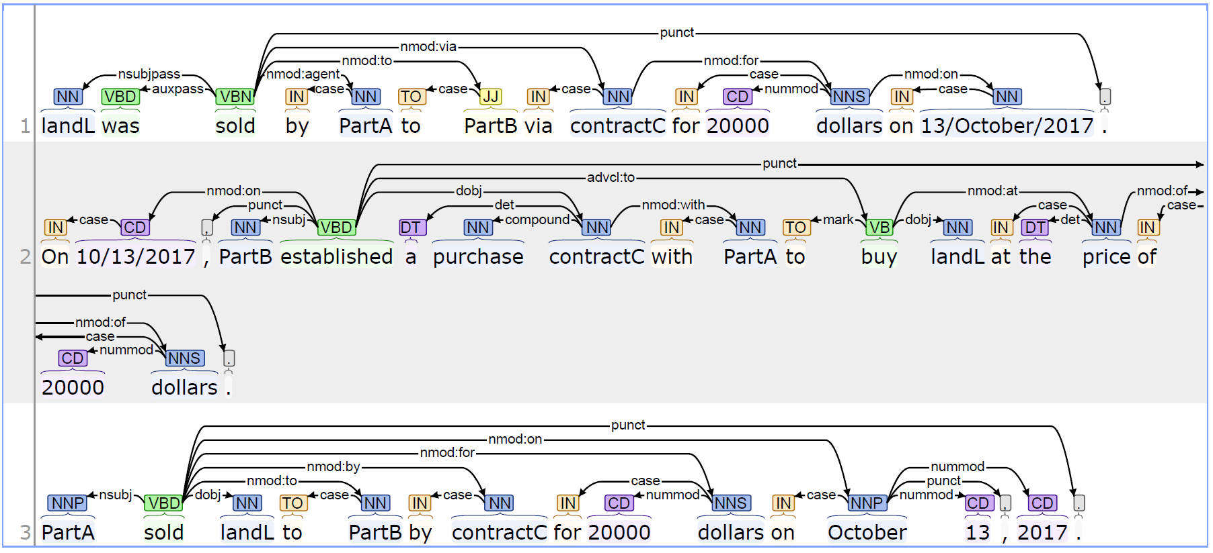
Main challenge
Paraphrasing:
Lots of ways to express the same information.
Different semantics.
Buy, purchase, acquire, sign a purchase contract, establish a contract… sell!
Different syntaxis:

Slide 19
CONTRACTFRAMES
Our framework

Slide 20
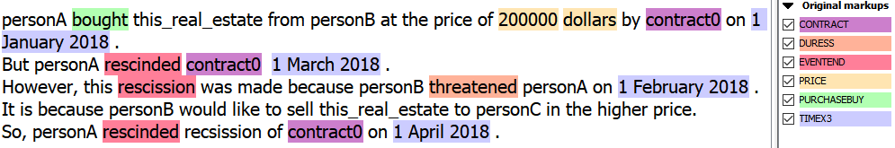
ContractFrames
Framework to deal with events in purchase contracts:
Uses CoreNLP tools.
Dedicated rules for event processing.
Middle representations as frames.
Final output:
PROLEG facts.
Linked Data.
Visual xml:
Also an ontology for representation in a standard way.

Slide 21
Our framework

Slide 22
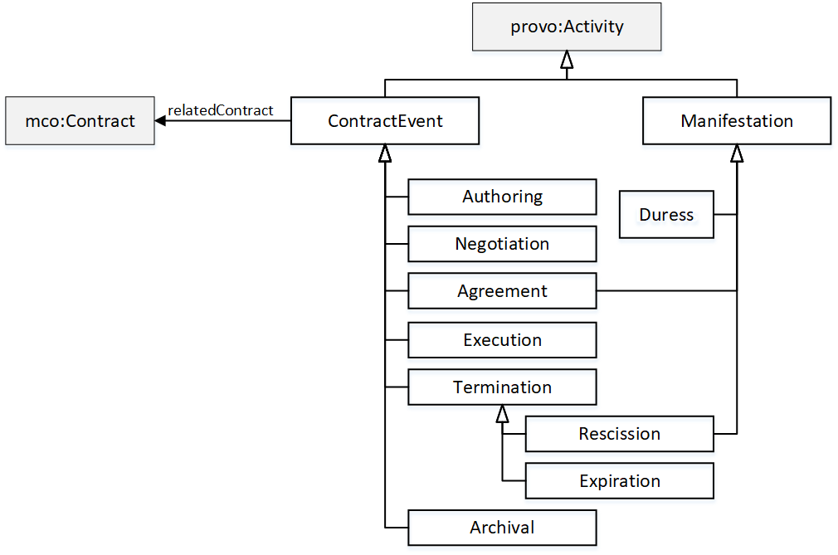
Our Ontology
Contract Workflow Ontology

Slide 23
RDF output
<https://mnavasloro.github.io/ContractFrames/data/e628571e-ad26-4537-8061-9a8fd378fd19> <http://www.w3.org/1999/02/22-rdf-syntax-ns#type> <https://mnavasloro.github.io/ContractFrames/Agreement> . <https://mnavasloro.github.io/ContractFrames/data/e628571e-ad26-4537-8061-9a8fd378fd19> <http://purl.oclc.org/NET/mco-core/party> "A" . <https://mnavasloro.github.io/ContractFrames/data/e628571e-ad26-4537-8061-9a8fd378fd19> <http://purl.oclc.org/NET/mco-core/entity> "L" . <https://mnavasloro.github.io/ContractFrames/data/e628571e-ad26-4537-8061-9a8fd378fd19> <https://mnavasloro.github.io/ContractFrames/price> "price" . <https://mnavasloro.github.io/ContractFrames/data/e628571e-ad26-4537-8061-9a8fd378fd19> <https://mnavasloro.github.io/ContractFrames/relatedContract> "price" . <https://mnavasloro.github.io/ContractFrames/data/e628571e-ad26-4537-8061-9a8fd378fd19> <http://purl.org/dc/terms/date> "2018 year 04 month 01 day" . <https://mnavasloro.github.io/ContractFrames/data/d6f87e79-c68f-4116-ae06-dca566827891> <http://www.w3.org/1999/02/22-rdf-syntax-ns#type> <https://mnavasloro.github.io/ContractFrames/Manifestation> . <https://mnavasloro.github.io/ContractFrames/data/d6f87e79-c68f-4116-ae06-dca566827891> <https://mnavasloro.github.io/ContractFrames/manifester > "A" . <https://mnavasloro.github.io/ContractFrames/data/d6f87e79-c68f-4116-ae06-dca566827891> <https://mnavasloro.github.io/ContractFrames/manifestee > "B" . <https://mnavasloro.github.io/ContractFrames/data/d6f87e79-c68f-4116-ae06-dca566827891> <https://mnavasloro.github.io/ContractFrames/rescission > "contract" . <https://mnavasloro.github.io/ContractFrames/data/d6f87e79-c68f-4116-ae06-dca566827891> <http://purl.org/dc/terms/date> "2018 year 05 month 01 day" . <https://mnavasloro.github.io/ContractFrames/data/d6f87e79-c68f-4116-ae06-dca566827891> <http://www.w3.org/1999/02/22-rdf-syntax-ns#type> <https://mnavasloro.github.io/ContractFrames/Duress> . <https://mnavasloro.github.io/ContractFrames/data/d6f87e79-c68f-4116-ae06-dca566827891> <https://mnavasloro.github.io/ContractFrames/manifester > "B" . <https://mnavasloro.github.io/ContractFrames/data/d6f87e79-c68f-4116-ae06-dca566827891> <https://mnavasloro.github.io/ContractFrames/manifestee > "A" . <https://mnavasloro.github.io/ContractFrames/data/d6f87e79-c68f-4116-ae06-dca566827891> <http://purl.org/dc/terms/date> "2018 year 04 month 15 day" . <https://mnavasloro.github.io/ContractFrames/data/d6f87e79-c68f-4116-ae06-dca566827891> <https://mnavasloro.github.io/ContractFrames/rescission > "contract" . <https://mnavasloro.github.io/ContractFrames/data/cad0512f-22a5-4fff-9975-b5ad1abafcb7> <http://www.w3.org/1999/02/22-rdf-syntax-ns#type> <https://mnavasloro.github.io/ContractFrames/Manifestation> . <https://mnavasloro.github.io/ContractFrames/data/cad0512f-22a5-4fff-9975-b5ad1abafcb7> <https://mnavasloro.github.io/ContractFrames/manifester > "A" . <https://mnavasloro.github.io/ContractFrames/data/cad0512f-22a5-4fff-9975-b5ad1abafcb7> <https://mnavasloro.github.io/ContractFrames/manifestee > "B" . <https://mnavasloro.github.io/ContractFrames/data/cad0512f-22a5-4fff-9975-b5ad1abafcb7> <https://mnavasloro.github.io/ContractFrames/rescission > "rescission(contract)" . <https://mnavasloro.github.io/ContractFrames/data/cad0512f-22a5-4fff-9975-b5ad1abafcb7> <http://purl.org/dc/terms/date> "2018 year 06 month 01 day" .

Slide 24
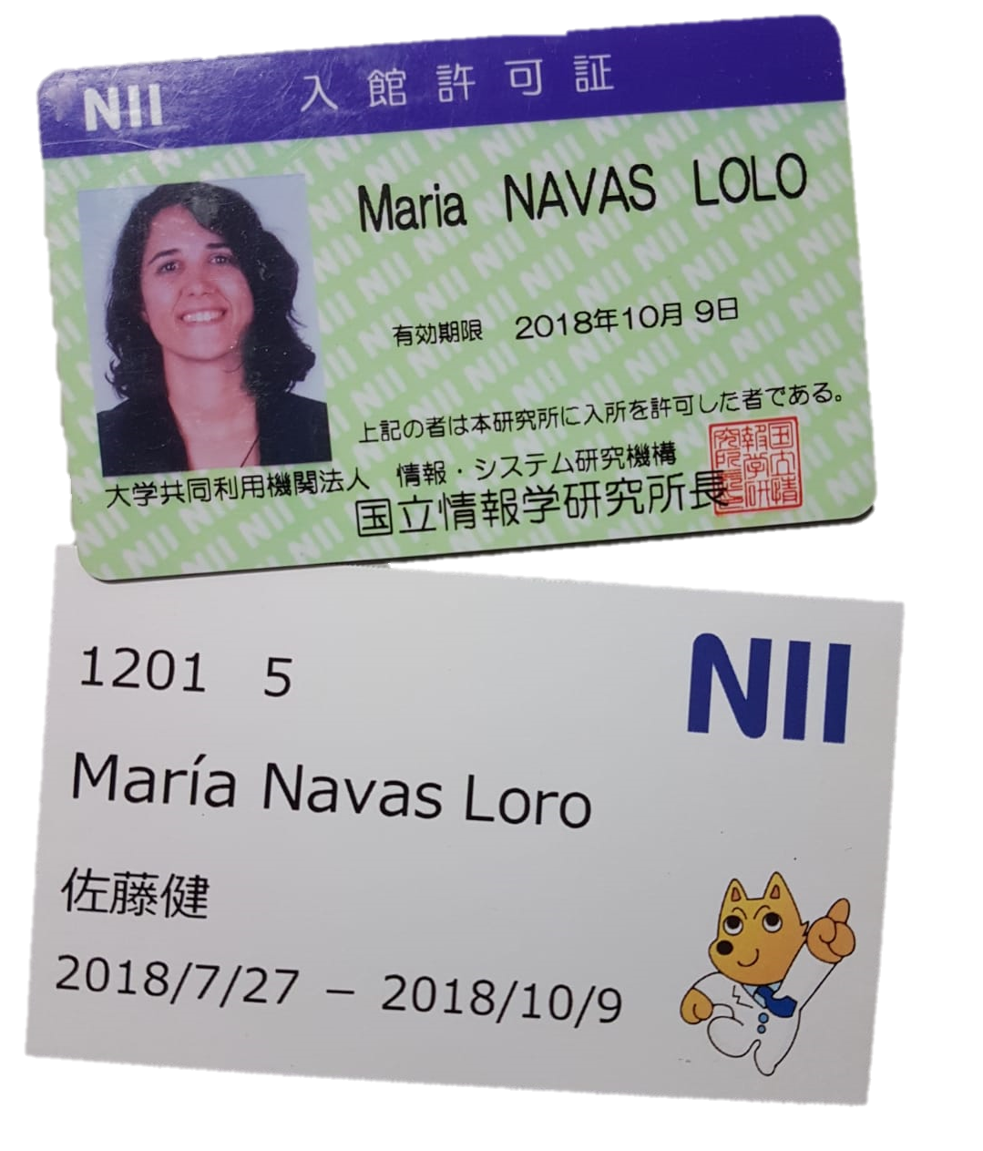
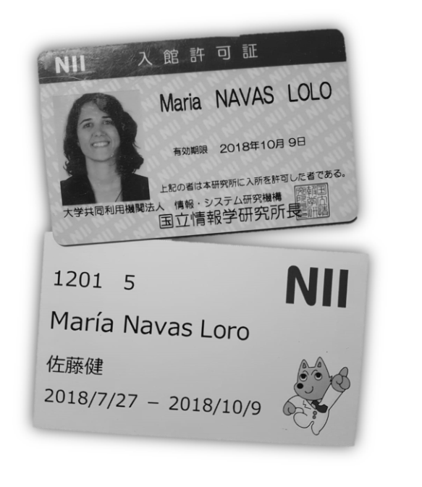
ADDITIONAL INFO
Just for OEG :)

Slide 25
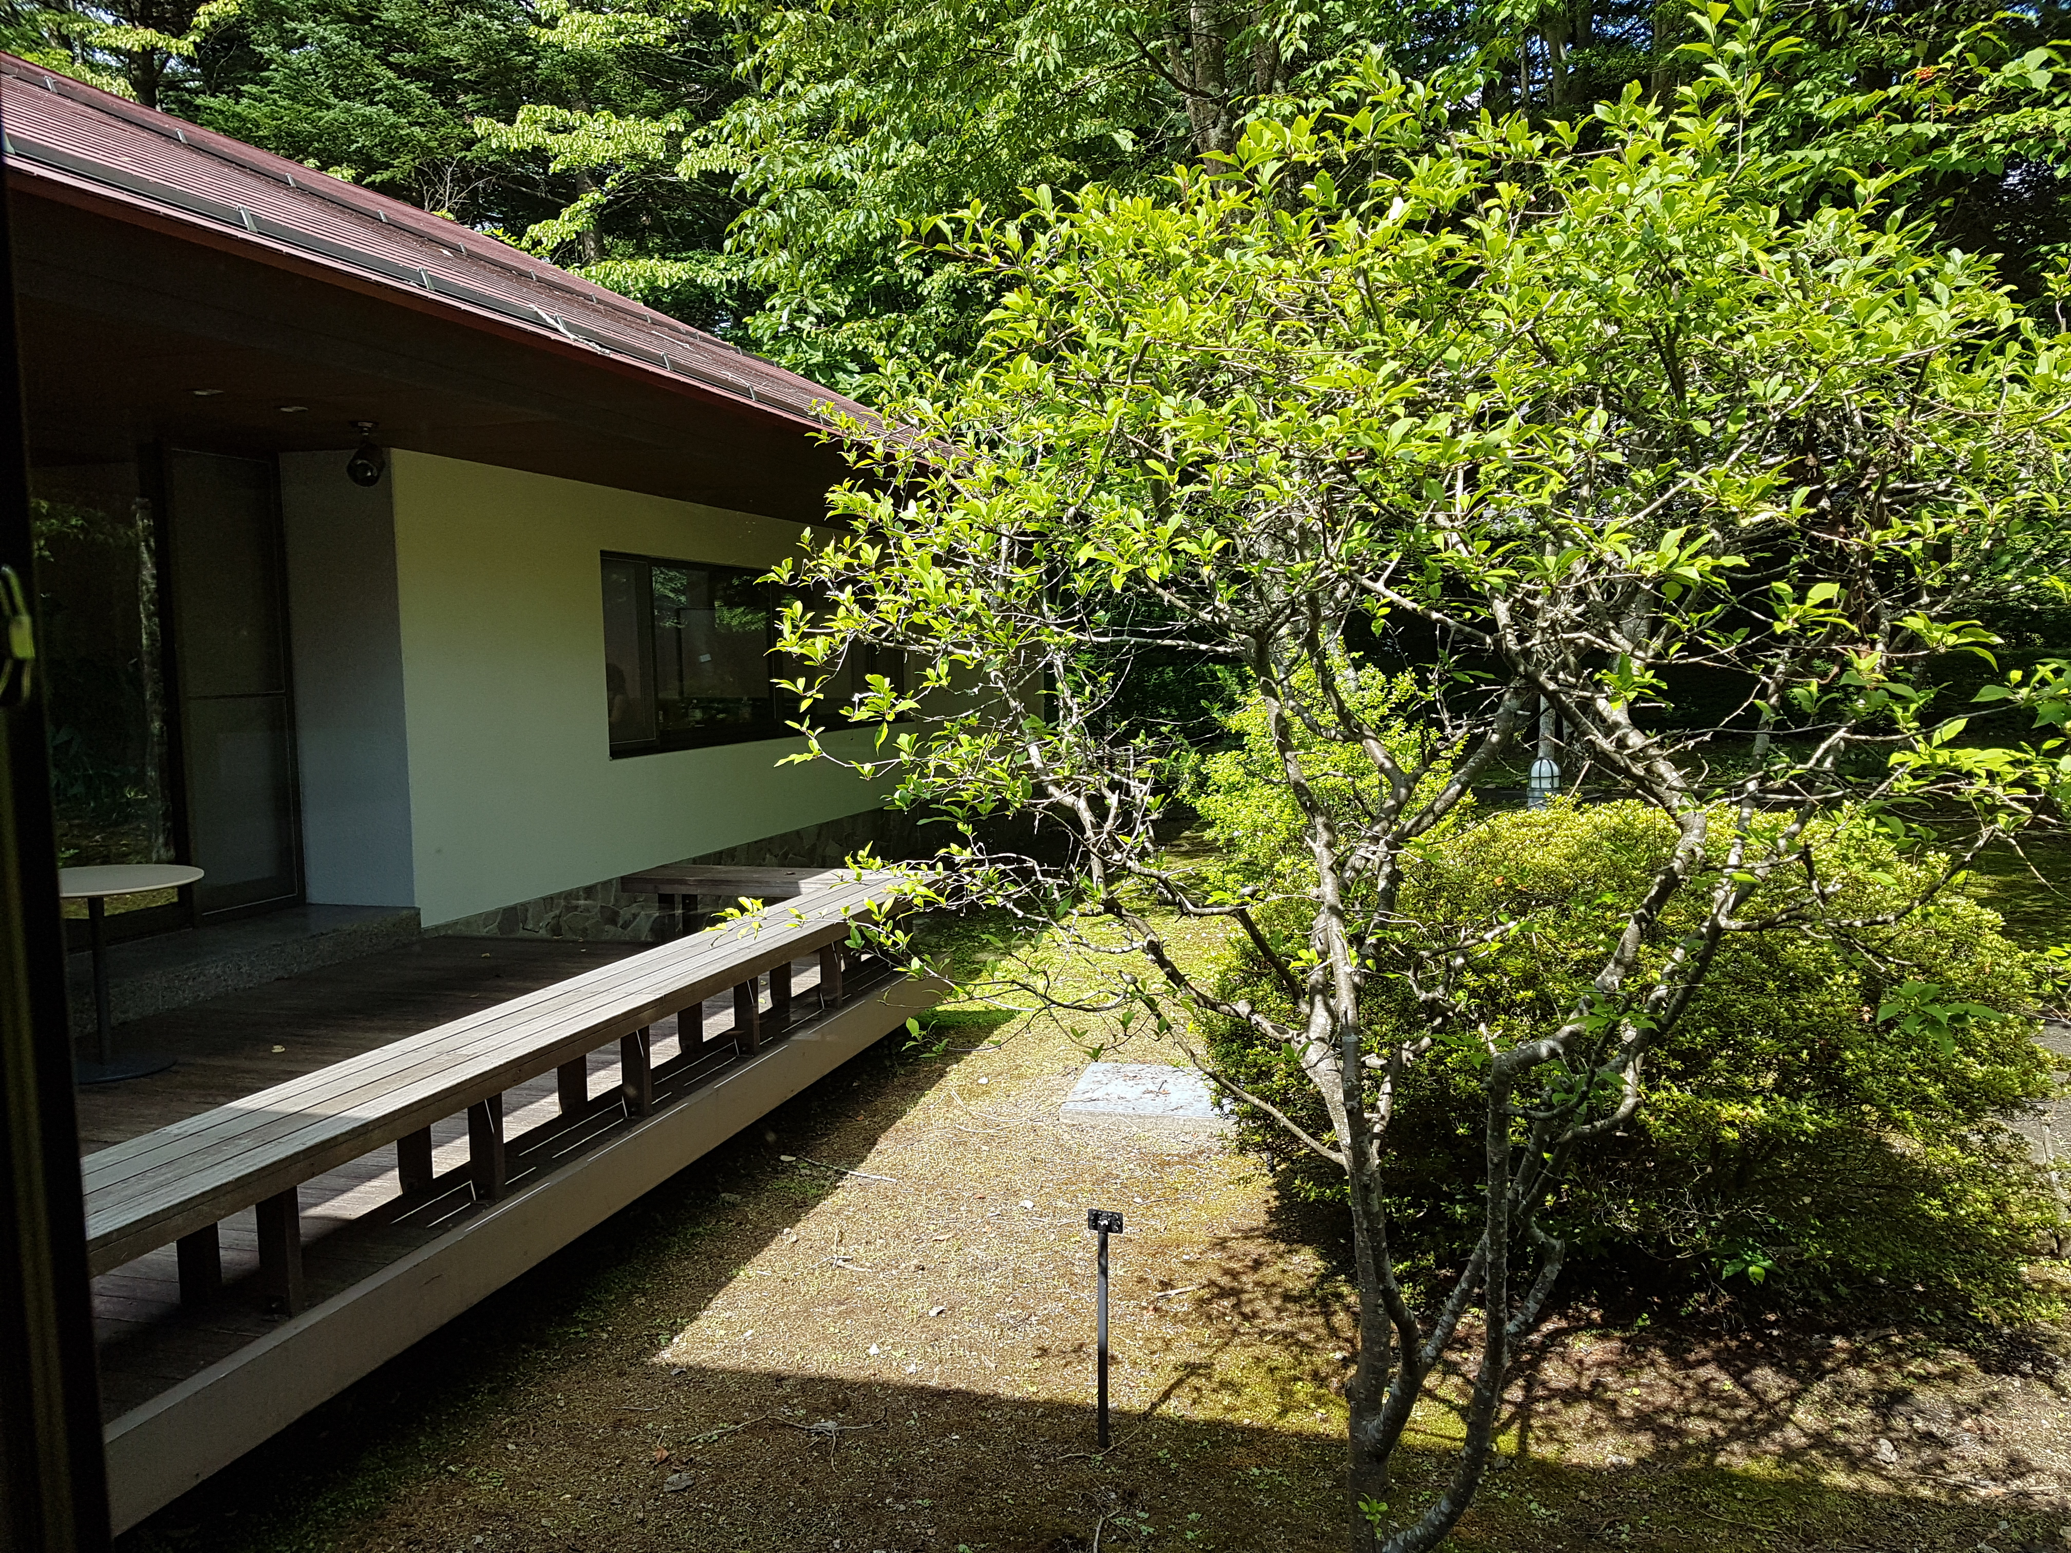
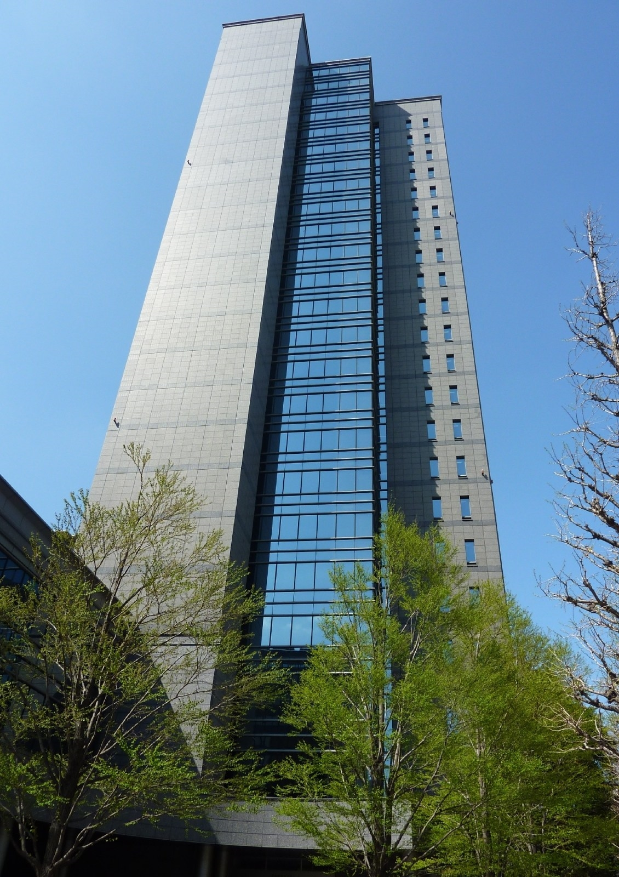
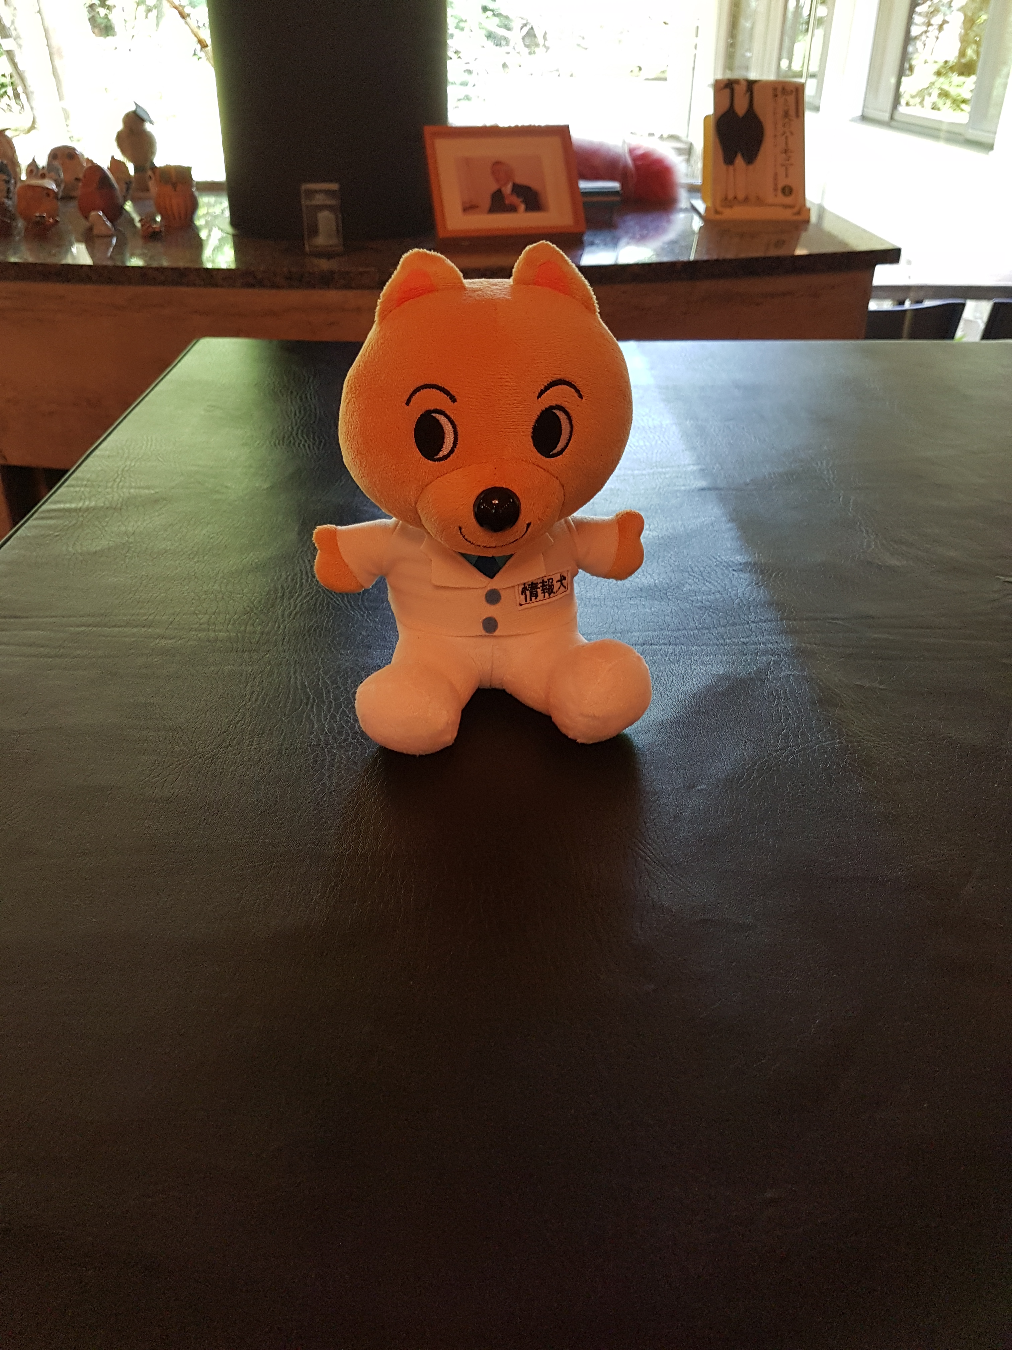
NII
A lot of seminars (Machine Understanding, Logics…)
Research Camp in Karuizawa (“Japanese Cercedilla”)
Not very interesting.
Each one worked on their stuff, if you wanted to discuss something with other people, you ask.
Emails with publications
Monthly food meetings paying ¥100

Slide 26
Group Organization
Ken Satoh is the leader
He gets interns for short periods of time (2-6 months).
He gets postdocs for medium periods of time (7 months-2 years).
Additionally, a group of Japanese people:
No contact
Working in PROLEG
Very mysterious.
We had weekly meetings (plus some one-to-one)
He prefers to work with foreign people.
He has a lot of money to travel (offered to pay even my JURIX travel, and payed Karuizawa, about 17550).
Interested in Lynx project, from the reasoning point of view.

Slide 27
Other work
Attempt to participate in COLIEE:
QA problem on legal texts.
Japanese and English version of corpora.
Approach:
Look for events
Look for noun groups.
Problems:
No resources for synonyms, hyperonyms…
Need of legal knowledge.
Need of Japanese context knowledge:
Valuable goods ~ kimono
Decided to focus on Event Calculus.
Then, we expanded it to directly translate to PROLEG.

Slide 28
People met
Ken Satoh (Supervisor, expert in legal reasoning):
First PhD arrived when I left, Wachada-san, debugging PROLEG.
Tiago Oliveira (Biomedical):
2-year - Postdoc (looking for job), matched with Pablo.
Thomas Agnotes:
7 months – Postdoc, working on Logics.
(Briefly) Josef Valvoda (Univ. Bristol)
Same internship, left one week after I arrived.
Working on seeing agreement between judges.
Randy Goebel (Univ. Alberta) - visitor
Legal reasoning in Canada, working on argumentation.
The Canadian Pompeu.
(Briefly) Patrik Schneider (TU Wien)
Former student of Axel Polleres…

Slide 29

CONCLUSIONS
To continue

Slide 30
Conclusions
Summary of the research stay:
ContractFrames.
NLP for detecting events.
Contract Workflow Ontology.
Publications:
Paper about ContractFrames submitted to:
JURIX
JURISIN
Ongoing/future work from this research stay:
Triplification process to allow separate reasoning.
A sells X to B
Exploring FRED.
{E, subj, A}
{E, obj, B}
{E, dobj, X}
{E, type, sell}

Slide 31
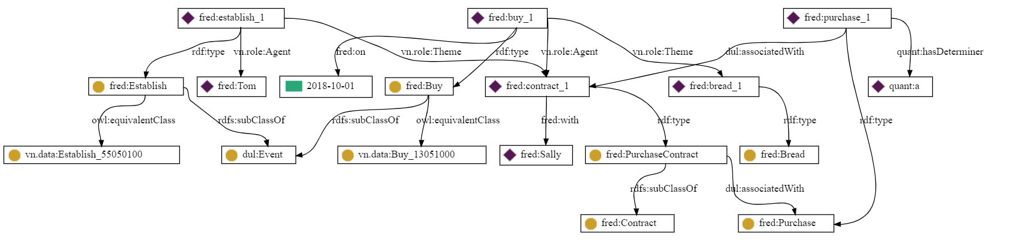
FRED
Tom established a purchase contract with Sally to buy bread on October 1 2018.

Slide 32
Bridging the gap between NLP and PROLEG
Internship Research Summary Talk
H30.7.27 – H30.10.9
Supervisor: Prof. Ken Satoh
María Navas-Loro
Ontology Engineering Group
Universidad Politécnica de Madrid, Spain
mnavas@fi.upm.es
@mnavas314
05/10/2018
National Institute of Informatics

